Slide 1
Congruent triangles (SSS)
Geometrical properties: similarity and Pythagoras' theorem

Slide 2
how to use Oak lessons

Slide 3
I can appreciate and use the criteria by which triangles are congruent (SSS).

Slide 4
If one shape can fit exactly on top of another using rotation, reflection or translation, then the shapes are congruent.

Slide 5

Congruent triangles (SSS)
Guaranteeing congruence
Justifying congruence by SSS

Slide 6
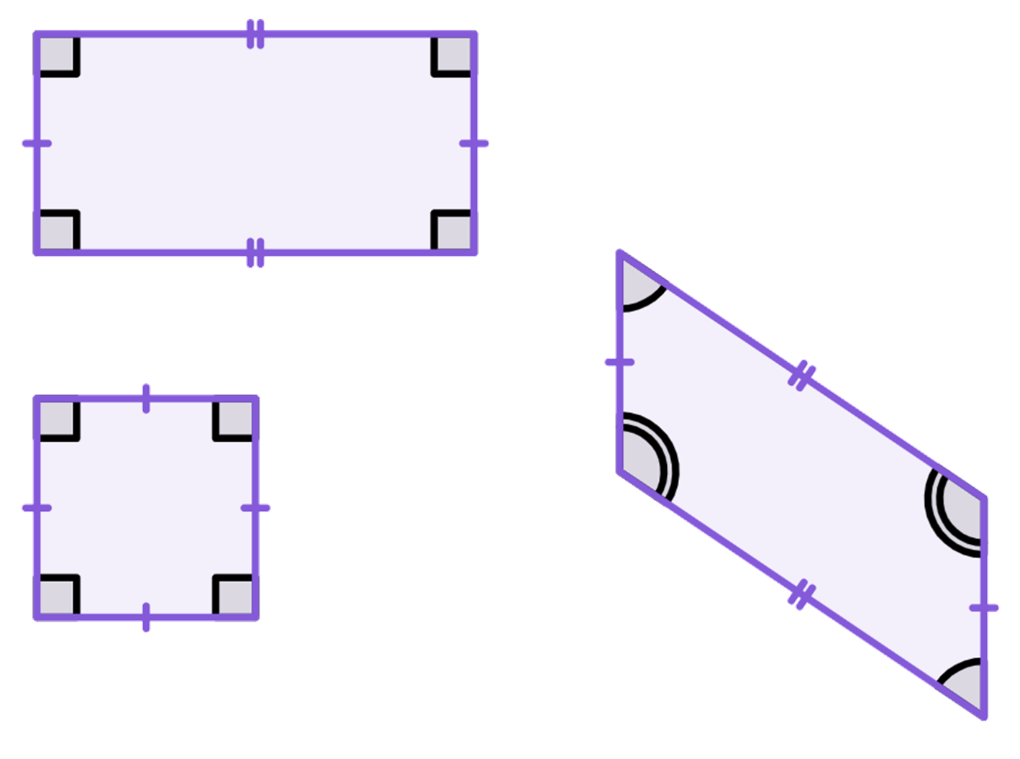
Guaranteeing congruence
To be congruent, two shapes need to be able to fit exactly on top of each other using rotation, reflection or translation.
Their angles and edges will be the same size, and in the same relative position within the shape.
The square and rectangle have the same angles but are different shapes.
The rectangle and parallelogram have the same length edges in the same order but have different angles.
3 cm
6 cm
3 cm
6 cm
124°
56°
3 cm
None of these are congruent to each other.

Slide 7
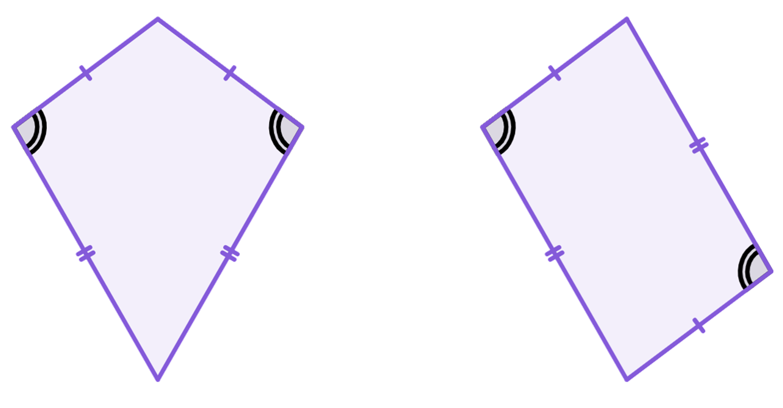
Guaranteeing congruence
Both of these quadrilaterals have two edges of 5 cm and 8.1 cm. They both have two angles of 97.1°. Are they congruent?
No, the other two angles are not the same and the edges are in different relative positions.
5 cm
5 cm
8.1 cm
97.1°
97.1°
8.1 cm

Slide 8
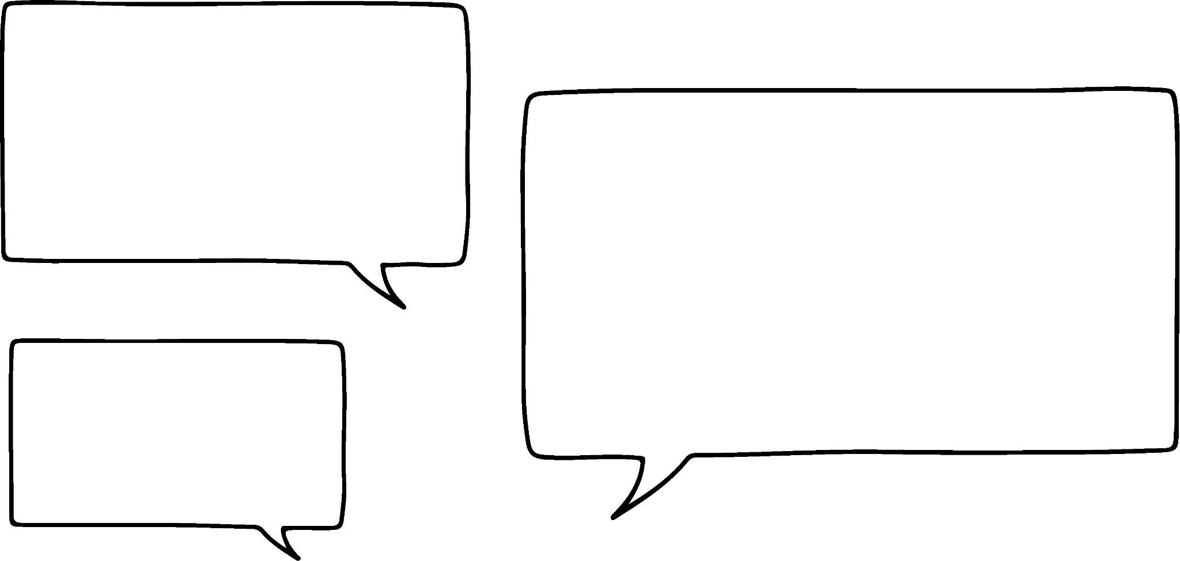

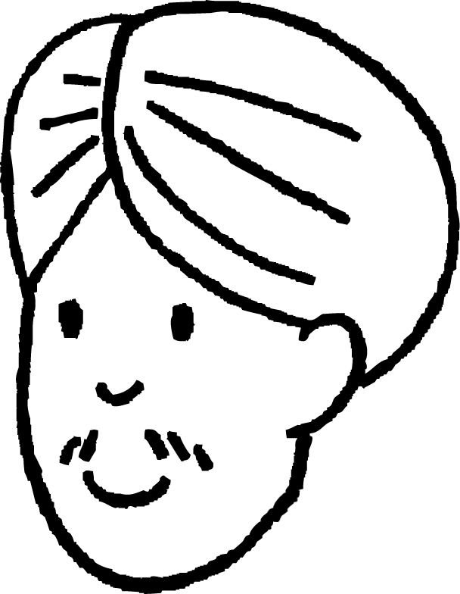
Guaranteeing congruence
So to be sure that two quadrilaterals are congruent, you need:
the corresponding edges to be the same
the order of the edges to be the same
the interior angles of the quadrilaterals to be the same
the angles to be in the same location
One or two of these alone, is not sufficient.
Are these all necessary for triangles?
Well the order of the edges is always the same.
Is that true?

Slide 9
Guaranteeing congruence
swap a and b
c
Yes! If you have three edges, a, b and c. Then swap two of the edges, the order is still the same.
They are always next to the other two sides.
a
b
b
b
c
c
b
c
a
swap b and c
swap a and c
a
a

Slide 10
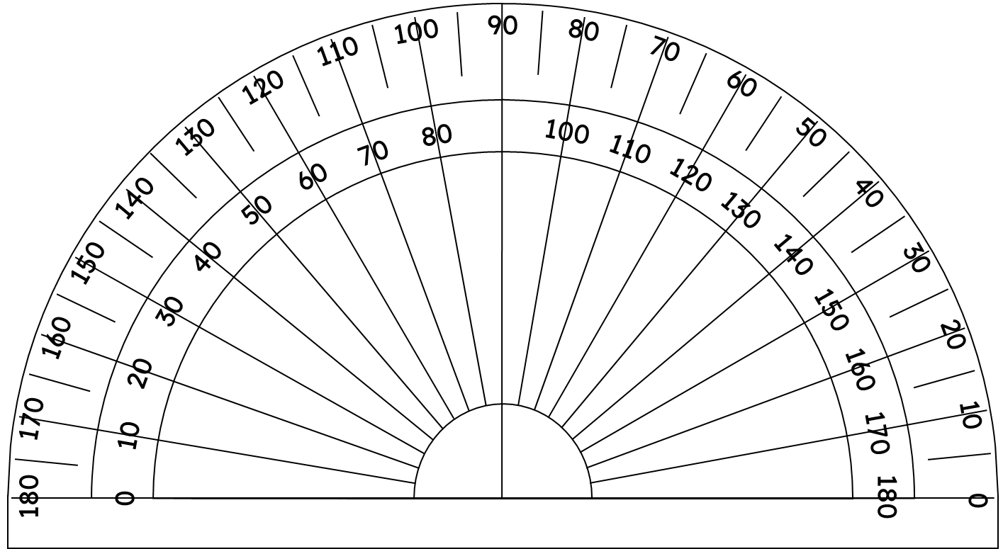
Guaranteeing congruence
Are these two triangles congruent?
60°
60°
60°
60°
60°
60°
We now know they are both equilateral triangles.

Slide 11
Guaranteeing congruence
Are these two triangles congruent?
They have the same interior angles, so they are similar.
60°
60°
60°
60°
60°
60°
6.3 cm
6.5 cm
Their edge lengths are different, so they are not congruent.

Slide 12
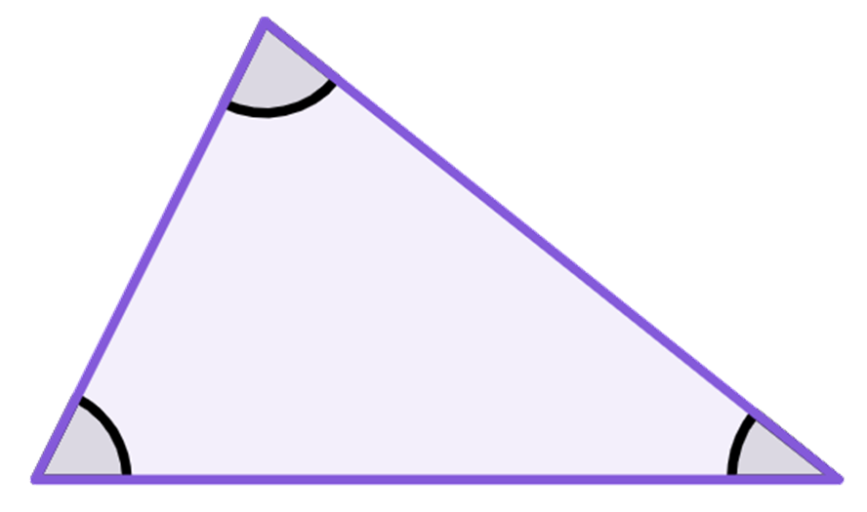

Guaranteeing congruence
The angles are the same. The triangles are congruent.
A
4.5 cm
78°
6.4 cm
63°
39°
B
C
Is Lucas correct?
7 cm
Q
When the angles are the same, the triangles are similar.
We need to know the edge lengths, to be able to tell if they are congruent.
78°
63°
39°
R
P

Slide 13
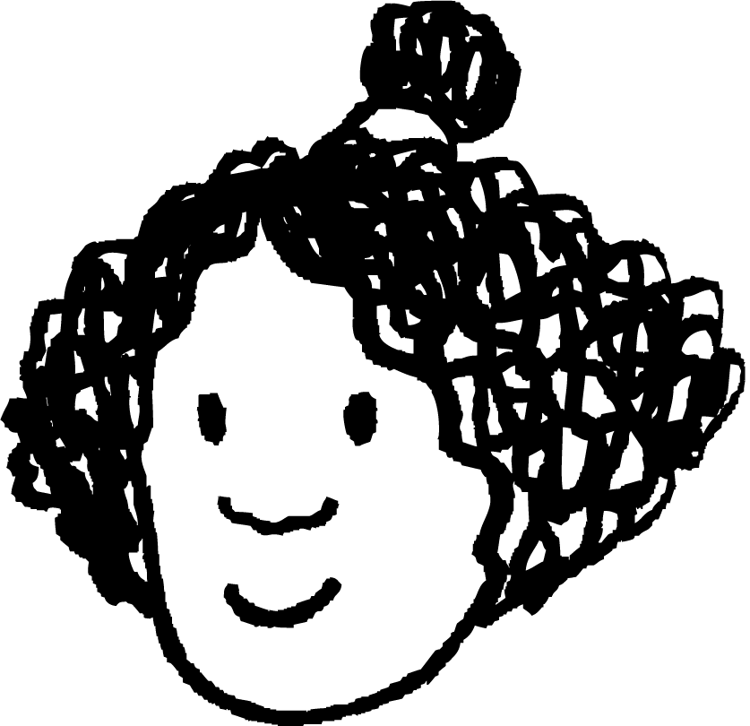

Guaranteeing congruence
If the corresponding sides and angles are the same then the two triangles are congruent.
If two triangles have the same angles, that means they are similar.
Izzy
Do we need to know all of that information to be sure they are congruent?
Let us take a look at it …
Alex

Slide 14
Guaranteeing congruence
With two side lengths connected at a vertex, an angle is created.
3.1 cm
3.1 cm
3.1 cm
31°
4.8 cm
85°
98°
4.8 cm
4.8 cm
By connecting the ends of the line segments, three different triangles are created.

Slide 15
Guaranteeing congruence
Can two triangles with the same three sides have different interior angles?
Here are three circles. The radius of each is the fixed length of an edge.
r₃ = 3.9 cm
r₁ = 3.2 cm
r₂ = 2.1 cm
🖇 SSS

Slide 16
Guaranteeing congruence
Can two triangles with the same three sides have different interior angles?
If two of the circles, are centred at the same point, then an angle is formed with two of the edges.
r₃ = 3.9 cm
As the angle changes the third length also changes.
r₁ = 2.1 cm
🖇 SSS
r₂ = 3.2 cm

Slide 17
Guaranteeing congruence
Can two triangles with the same three sides have different interior angles?
To create a triangle with the third edge of the last circle, it needs to be centred on one end of a radius and the other radius needs to be on the circumference of it.
3.9 cm
These two triangles are congruent, they are reflections of each other.
3.9 cm
2.1 cm
2.1 cm
3.9 cm
2.1 cm
3.9 cm
3.2 cm
3.2 cm
r₃ = 3.9 cm
3.2 cm
3.2 cm
r₁ = 2.1 cm
🖇 SSS
r₂ = 3.2 cm

Slide 18
Guaranteeing congruence
Can two triangles with the same three sides have different interior angles?
No, the side lengths, fix the size of the angles.
So two triangles with the same three edges, will be congruent?
Yes, if we know the edges are the same, then we know they are congruent.
3.9 cm
2.1 cm
3.2 cm
This condition for congruence in triangles is called side-side-side or SSS for short.
Izzy
Alex

Slide 19

Guaranteeing congruence
Which of these is not congruent to the other two?
Triangle ABC, where AB = 9 cm, BC = 3 cm and AC = 10 cm
Triangle DEF, where DE = 10 cm, DF = 9 cm and EF = 3 cm
Triangle GHI, where GH = 10 cm, GI = 3 cm and HI = 10 cm

Slide 20
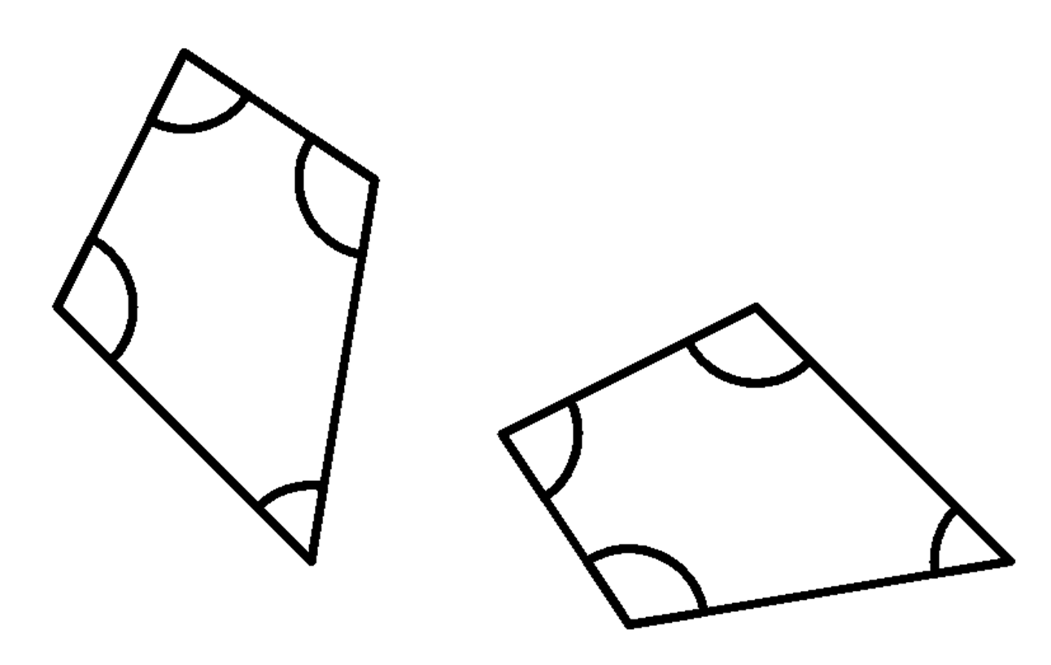
Guaranteeing congruence
1) These two quadrilaterals are congruent. Fill in the blanks.
3.6 cm
4.5 cm
83°
114°
83°
108°
55°
3.6 cm
5.7 cm
6.1 cm

Slide 21
Guaranteeing congruence
2) Give an example of quadrilaterals that show that these conditions are not enough to prove congruence.
a) angles are the same
b) angles are the same and in the same order
c) edges are the same length
d) edges are the same length and in the same order

Slide 22


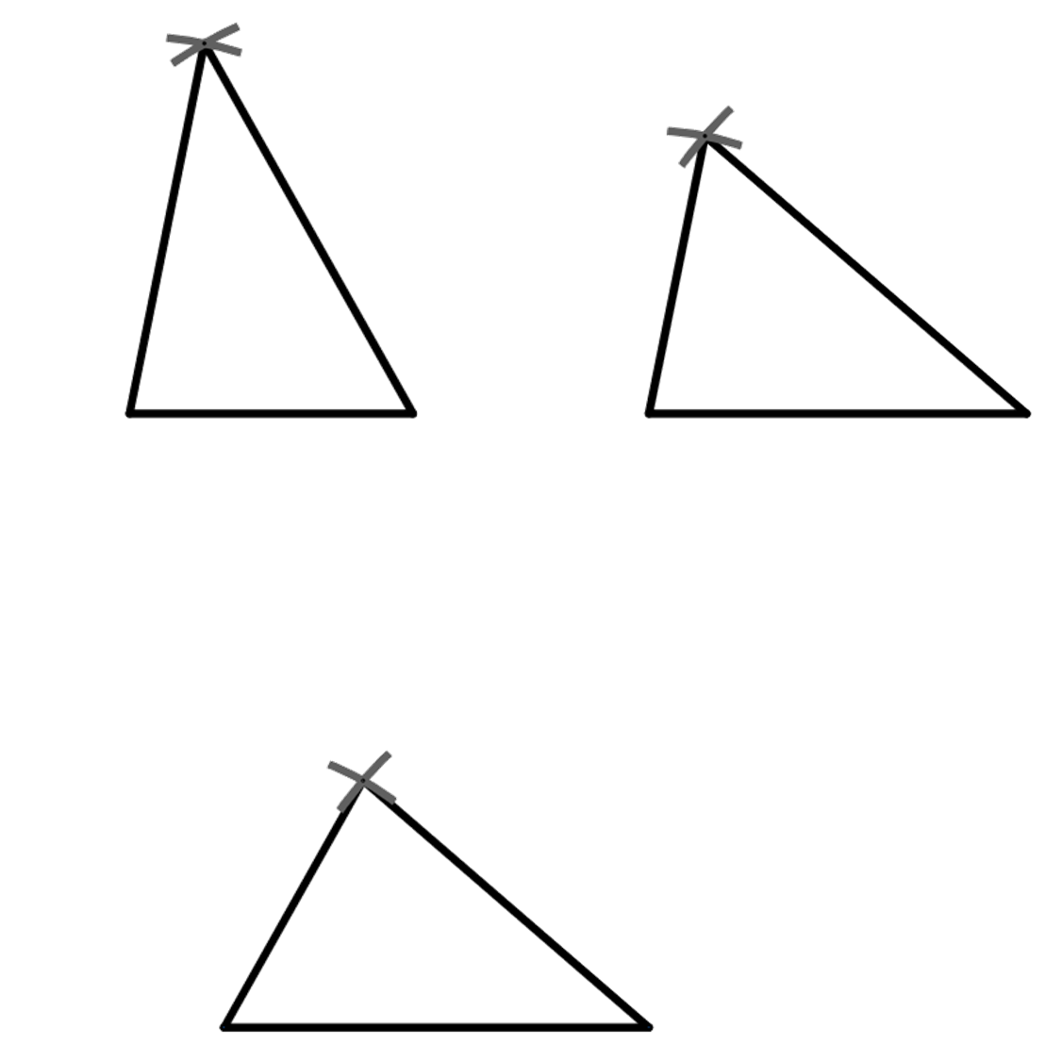
Guaranteeing congruence
3) The triangle ABC, where AB = x cm, AC = x cm and BC = x cm has been constructed three times.
C
B
A
A
B
A
C
B
C
a) measure the angles ABC, BAC and BCA in each of the three triangles
b) what do you notice?

Slide 23
Guaranteeing congruence
1) These two quadrilaterals are congruent. Fill in the blanks.
3.6 cm
4.5 cm
4.5 cm
83°
5.7 cm
114°
108°
83°
108°
114°
55°
3.6 cm
55°
5.7 cm
6.1 cm
6.1 cm

Slide 24
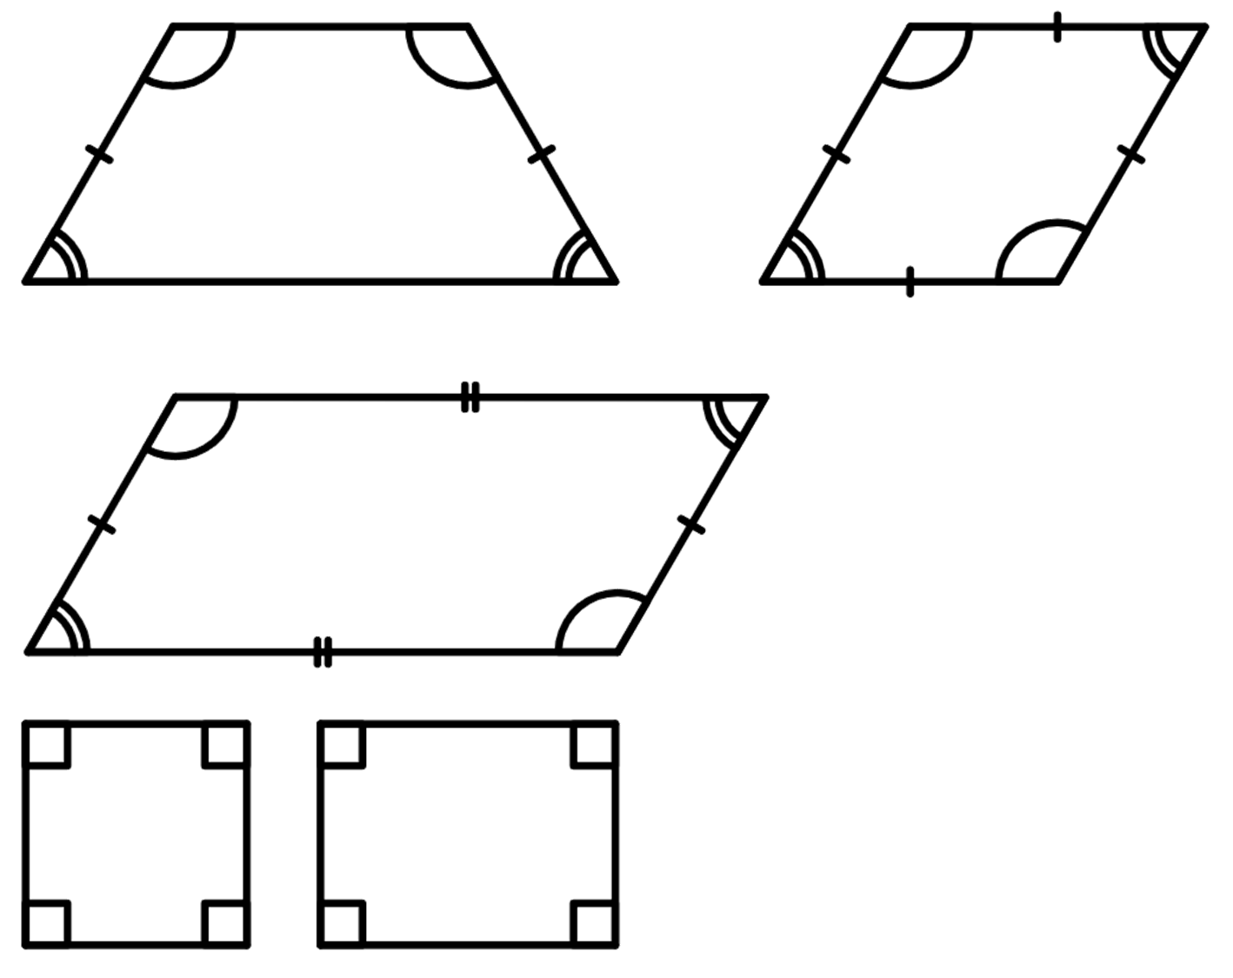
Guaranteeing congruence
2) Give an example of quadrilaterals that show that these conditions are not sufficient to prove congruence.
a) angles are the same
An isosceles trapezium and a parallelogram can have the same angles but they are not congruent.
120°
120°
60°
60°

Slide 25
Guaranteeing congruence
2) Give an example of quadrilaterals that show that these conditions are not sufficient to prove congruence.
b) angles are the same and in the same order
Squares and rectangles have four right angles but are not congruent.
Parallelograms and rhombi can have the same angles in the same order but are not congruent.
120°
120°
60°
60°

Slide 26
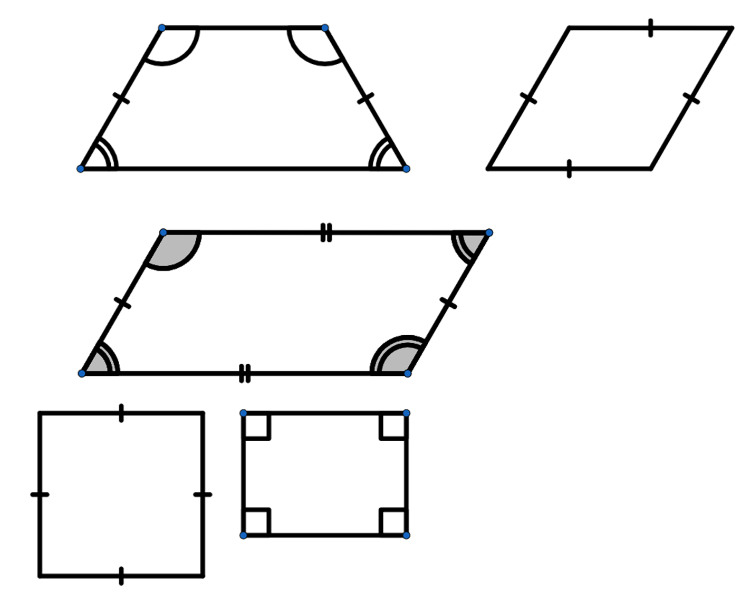
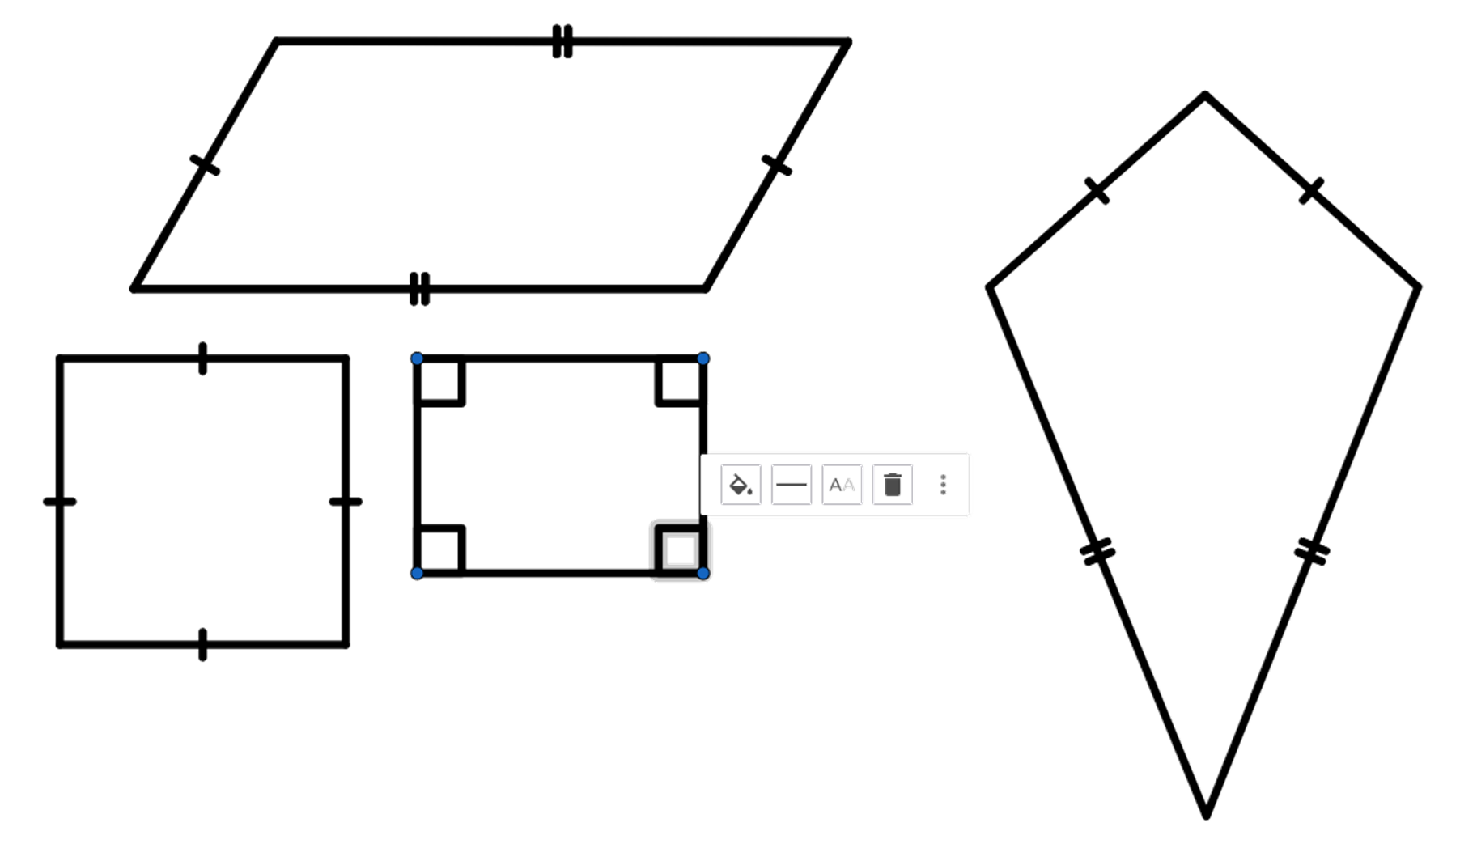
Guaranteeing congruence
2) Give an example of quadrilaterals that show that these conditions are not sufficient to prove congruence.
c) edges are the same length
Squares and rhombi can have the same edge lengths but are not congruent.
Kites and parallelograms can have the same lengths but are not congruent.

Slide 27
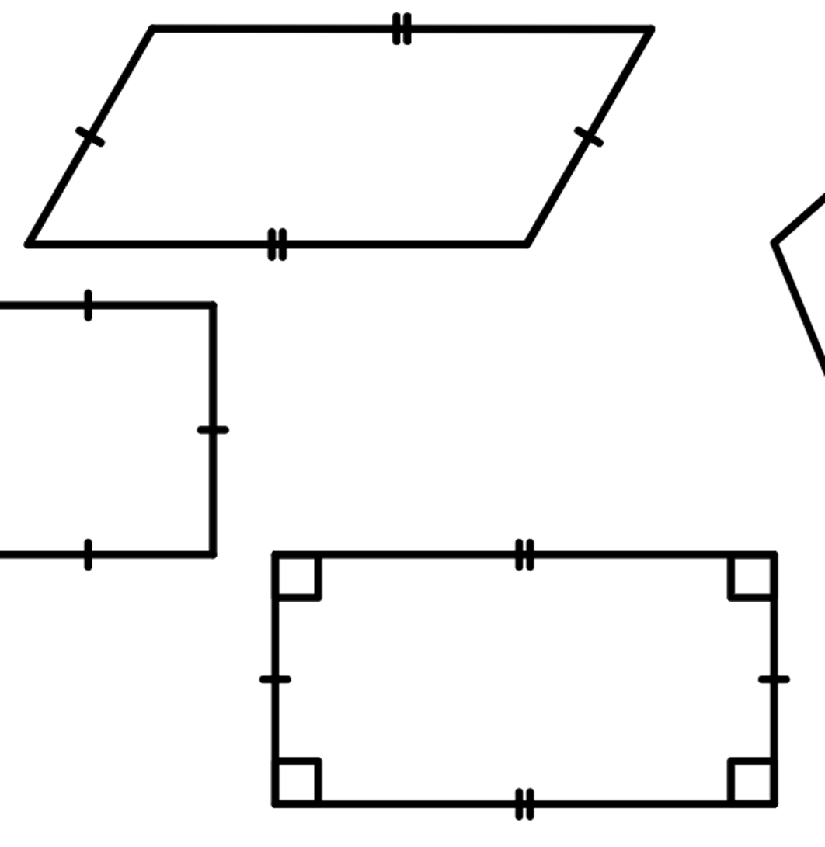
Guaranteeing congruence
2) Give an example of quadrilaterals that show that these conditions are not sufficient to prove congruence.
d) edges are the same length and in the same order
Rectangles and parallelograms can have the same edge lengths in the same order but are not congruent.

Slide 28
Guaranteeing congruence
3) The triangle ABC, where AB = x cm, AC = x cm and BC = x cm has been constructed three times,
Protractors are only accurate to the nearest degree, so your answer should be around this given value
C
40.8°
B
A
60.6°
78.6°
78.6°
60.6°
78.6°
60.6°
40.8°
40.8°
A
B
A
C
B
C
a) measure the angles ABC, BAC and BCA in each of the three triangles
b) what do you notice?
The angles are the same in each construction.

Slide 29
Congruent triangles (SSS)
How are they congruent?
Justifying congruence by SSS

Slide 30
Justifying congruence by SSS
We can be sure that two triangles are congruent if we know that the three edges are the same on both triangles.
6.5 cm
3.6 cm
6.5 cm
4.9 cm
4.9 cm
3.6 cm
The orientation and sense of the two triangles do not need to be the same.

Slide 31
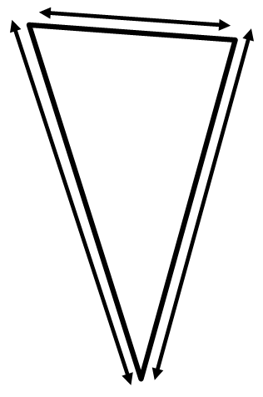
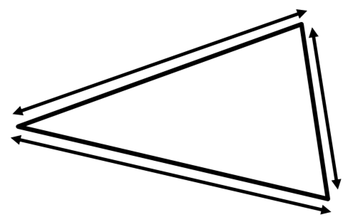
Justifying congruence by SSS
Using the fact that these two triangles are congruent, fill in the blanks.
3.6 cm
7 cm
3.6 cm
8.1 cm
8.1 cm
7 cm

Slide 32

Justifying congruence by SSS
Here is a rectangle with one of the diagonals marked.
A
Are the two triangles ABC and ADC congruent?
D
We could measure the three edges with a ruler.
B
C
I haven’t got a ruler, and it wouldn’t be completely accurate even if I did. But I think I can show that they are…
Andeep
Laura

Slide 33
Justifying congruence by SSS
Here is a rectangle with one of the diagonals marked.
A
Are the two triangles ABC and ADC congruent?
D
B
C
As it is a rectangle, AD = BC
Oh, by using the properties of the shape.
and AB = DC.
AC is an edge on both of the triangles.
Therefore triangle ABC and ADC have the same three edges, so they are congruent by SSS.

Slide 34
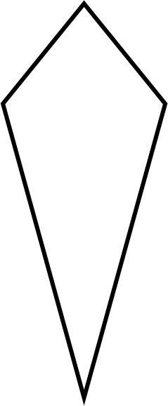
Justifying congruence by SSS
Prove that triangle ABC and triangle ACD are congruent in this kite.
A
As it is a kite, AB = AD.
B
D
It is also true that BC = DC.
AC is an edge on both of the triangles.
Therefore triangle ABC and ACD have the same three edges, so they are congruent by SSS.
C

Slide 35
Justifying congruence by SSS
1) By measuring the sides of these pair of triangles, decide if they are congruent or not.
Z
A
a)
C
Y
B
X
P
V
b)
R
T
Q
U

Slide 36
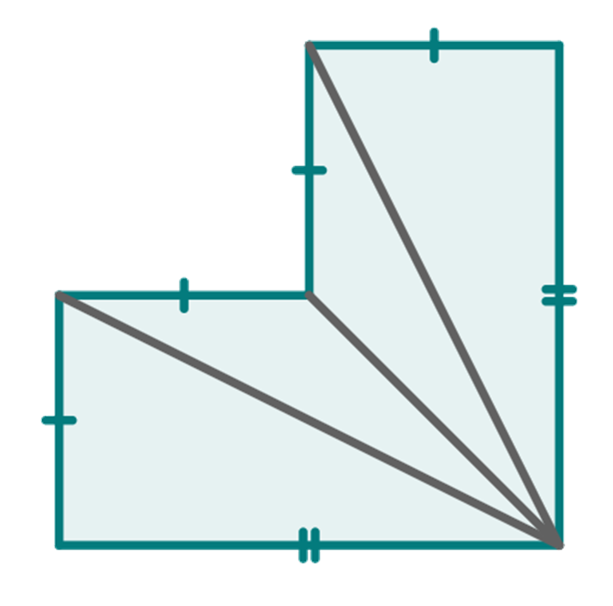
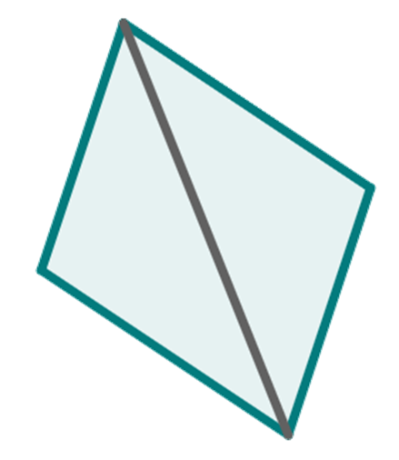
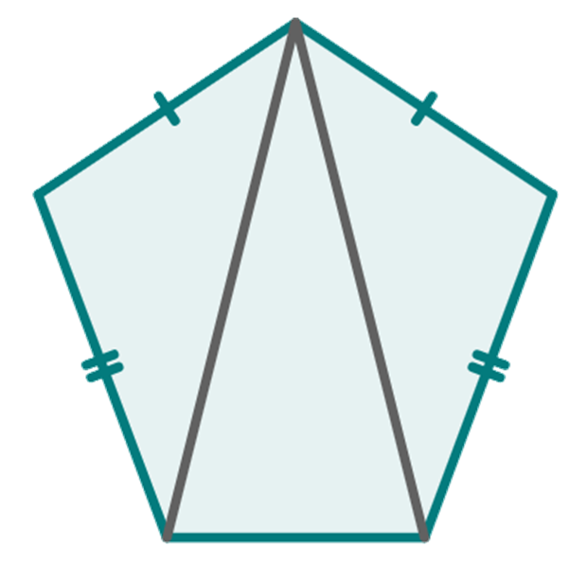
Justifying congruence by SSS
2) By using properties of shapes, identify the triangles that are congruent by SSS.
A
T
M
L
a)
b)
c)
P
S
N
D
I
B
Q
R
J
K
C
symmetrical pentagon
symmetrical hexagon
parallelogram

Slide 37
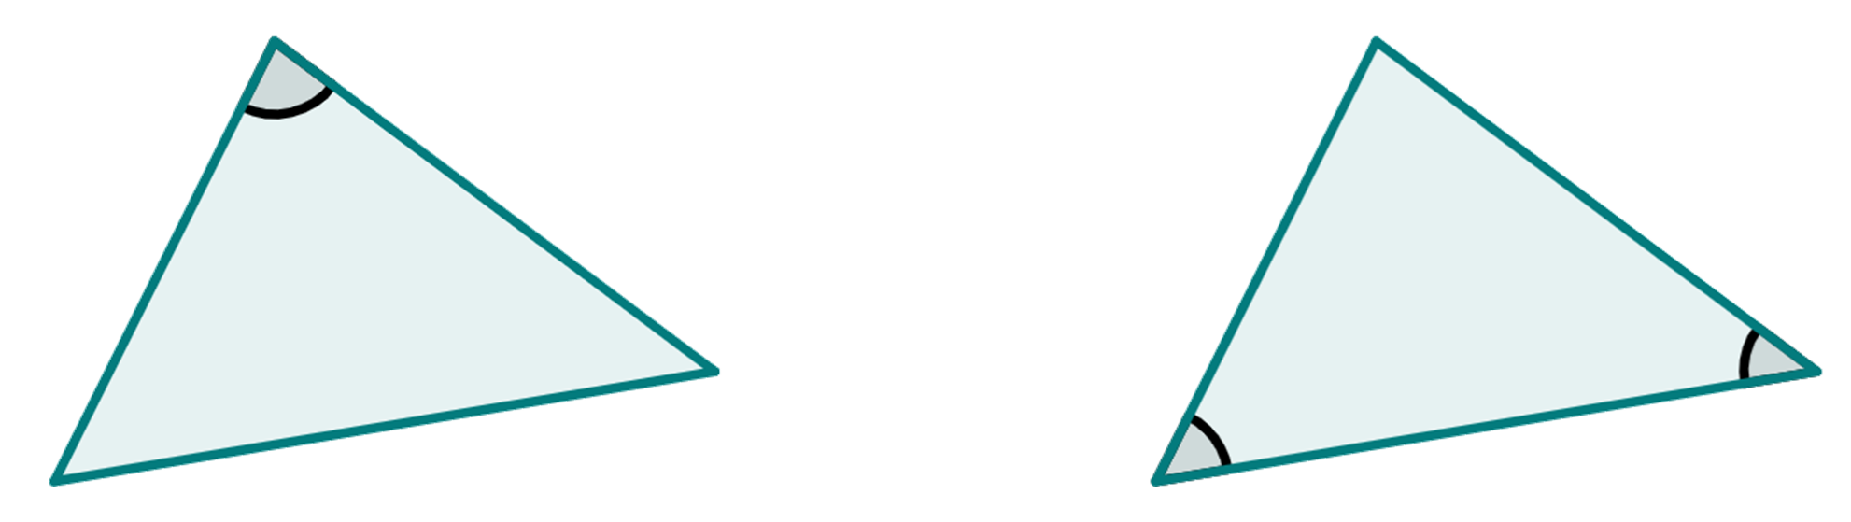
Justifying congruence by SSS
3) These triangles are congruent. Using this fact, add the edge length marked x.
80°
5 cm
4.5 cm
46°
54°
x cm
6.1 cm

Slide 38
Justifying congruence by SSS
1) By measuring the sides of these pair of triangles, decide if they are congruent or not.
Z
A
a)
They are congruent.
C
Y
B
X
P
V
b)
R
T
Q
They are not congruent.
U

Slide 39
Justifying congruence by SSS
2) By using properties of shapes, identify the triangles that are congruent by SSS.
A
T
M
L
a)
b)
c)
P
S
N
D
I
B
Q
R
J
K
C
symmetrical pentagon
symmetrical hexagon
parallelogram
⃤ ABC ≅ ⃤ ADC
⃤ TPQ ≅ ⃤ TSR
⃤ IJK ≅ ⃤ MLK
⃤ INK ≅ ⃤ MNK

Slide 40
Justifying congruence by SSS
3) These pairs of triangles are congruent. Using this fact, add the edge length marked x.
80°
5 cm
4.5 cm
46°
54°
6.1 cm
6.1 cm

Slide 41
Congruent triangles (SSS)
Two triangles can be proved to be congruent, if you know the three side lengths are the same.
The corresponding angle pairs are the same in congruent shapes.

Slide 42

© Oak National Academy 2024.
Produced in partnership with Mathematics in Education and Industry.
Licensed on the Open Government Licence v3.0, except where otherwise stated. See Oak terms and conditions.

